Slide 1




人工智能核心能力培养 — Lecture 07 Deep Learning and Neural Ntworks The Kernel Ability For Artificial Intelligence
高民权

Slide 2

deep learning and modern artificial intelligence
Lecture-07 Neural Networks, Activation Functions, Hyper parameters
Lecture-08 Convolutional Neural Network and image classification
Lecture-09 sequence learning, lstm, gru

Slide 3
Key points of neural networks
1. what’s the functionality of activation functions?
2. what’s the functionality of back-propagation and forward propagation?
3. what’s the gradient descent and what’s the stochastic gradient descent(SGD)?
4. what’s the topological sorting for neural network?

Slide 4

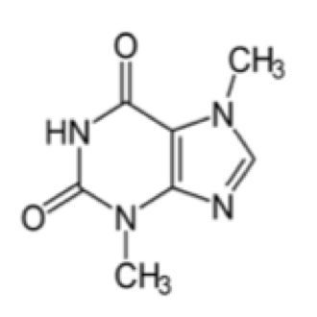

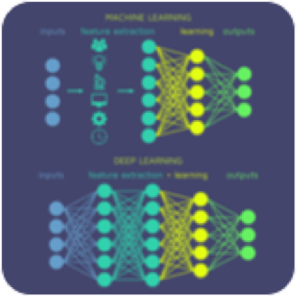
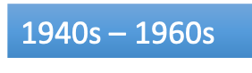
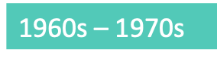
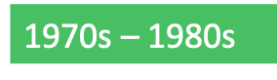

From if-else to Deep Learning
目前3/5的问题场景依然需要这些方法来解决
解决了诸多以前
无法突破的问题
·Search
·地图导航
·五子棋
·IBM深蓝
·简单的推理问题
·Knowledge Based
·医药问答
·行业专家系统
·语言判断
·Probability
·语音识别
·自动纠错
·更加复杂的决策系统
·Learning
·贝叶斯模型
·决策树
·神经网络
·深度学习

Slide 5
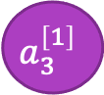
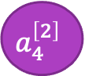
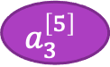
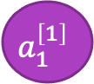

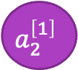
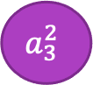


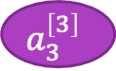


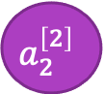


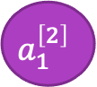

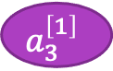
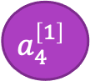


Some more key points for deep learning
3 * N
N * 5
3 * 5
1. Deep Learning中的相关表示方法
2. Matrix Dimension Right 确保矩阵的维度正确
3 * 4
b (3 *1)
b (N*1)
$$a_{1}^{\left[1\right]}$$
$$a_{1}^{\left[2\right]}$$
$$a_{3}^{\left[1\right]}$$
$$\hat{y_{0}}$$
$x_{0}$ （1 * 4）
W (3 *N)
W (N *1)
$$a_{2}^{\left[2\right]}$$
$$a_{3}^{\left[2\right]}$$
$$\hat{y_{1}}$$
$$a_{2}^{\left[1\right]}$$
$x_{1}$ （1 * 4）
$$a_{3}^{\left[3\right]}$$
$$\hat{y_{2}}$$
$$a_{3}^{\left[1\right]}$$
$$a_{3}^{2}$$
$x_{2}$ （1 * 4）
$$a_{3}^{[4]}$$
$$\hat{y_{3}}$$
$$a_{4}^{\left[1\right]}$$
$$a_{4}^{\left[2\right]}$$
$$a_{3}^{\left[5\right]}$$
$$\hat{y_{4}}$$

Slide 6
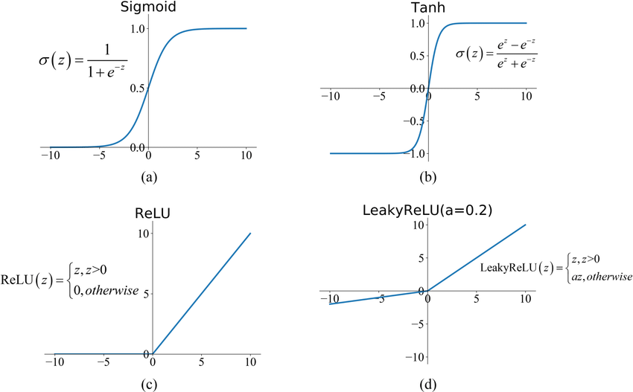
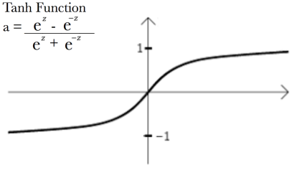
激活函数 Activation functions
常见激活函数的优势与劣势

Slide 7
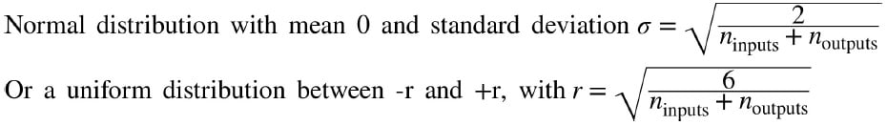
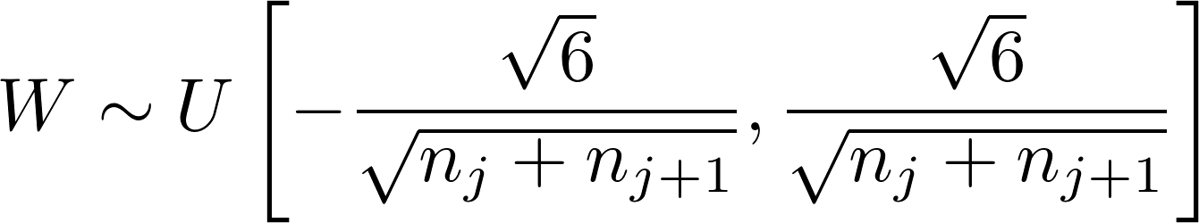
初始化 Initizalization
Weight Initialization is critical for training
-> If weights are initialized to be ZERO
-> If weights are randomized as normal distribution,
and bias as ZERO
The larger input X dimension is, the smaller of weights
-> Uniform Distribution for weight: Xavier initialization
x1
a1_1
a2
yhat
x2
a1_2

Slide 8
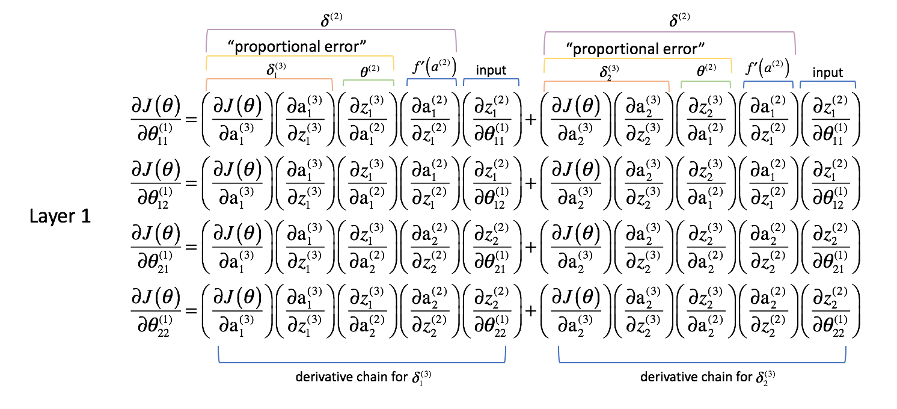
梯度消失与梯度爆炸

Slide 9
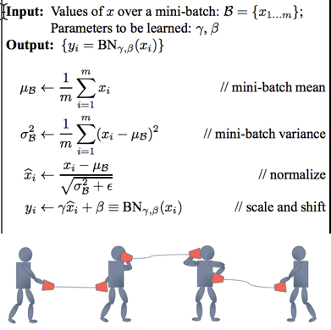
Batch normalization
Batch Normalization allows us to use much higher learning rates and be less careful about initialization.

Slide 10
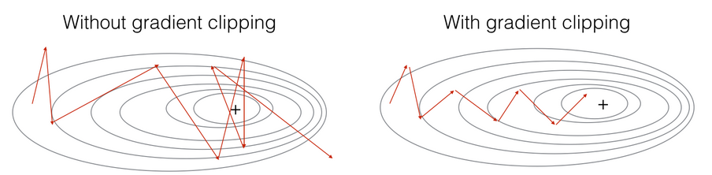
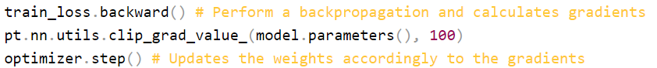
Gradient clipping
直接将过大的梯度值变小

Slide 11
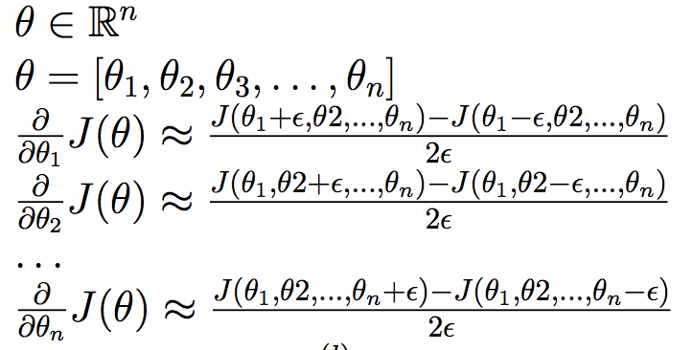
Gradient chekcing 梯度检查
When debug your neural networks

Slide 12

learning rate and stop early
如果深度学习模型不ok，那么将learning rate调小基本上可以让所有模型变化
但是?
我们可以设置成 learning-rate和loss是一个相关的函数，
Loss越小，learning-rate越小 (learning rate decay)
当我们发现loss连续k次不下降的时候，我们可以提前停止训练过程，这个方法叫做“early stop”

Slide 13
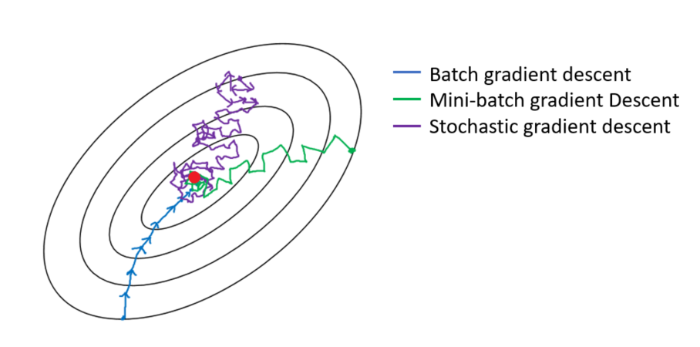
Optimizer 不同的优化方法
Batch Gradient Descent v.s Mini-Batch Gradient Descent vs Stochastic Gradient Descent
Training Data
Samples feed to tranining

Slide 14
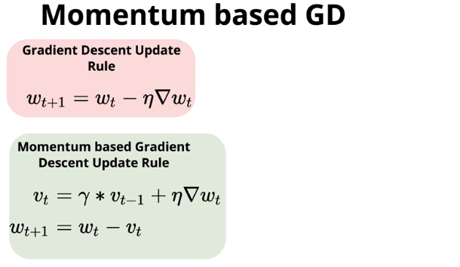
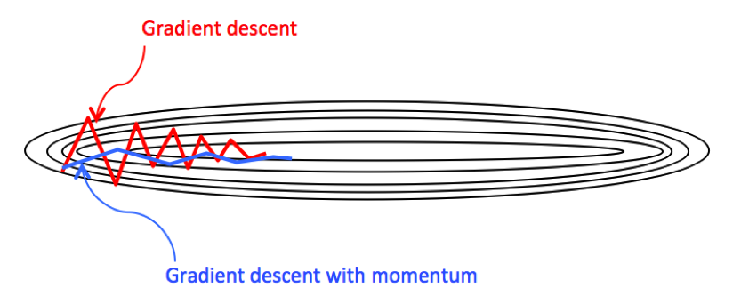
Gradient with momentum

Slide 15
RMS-prop (Root mean square prop)
Slow down
Speed up

Slide 16
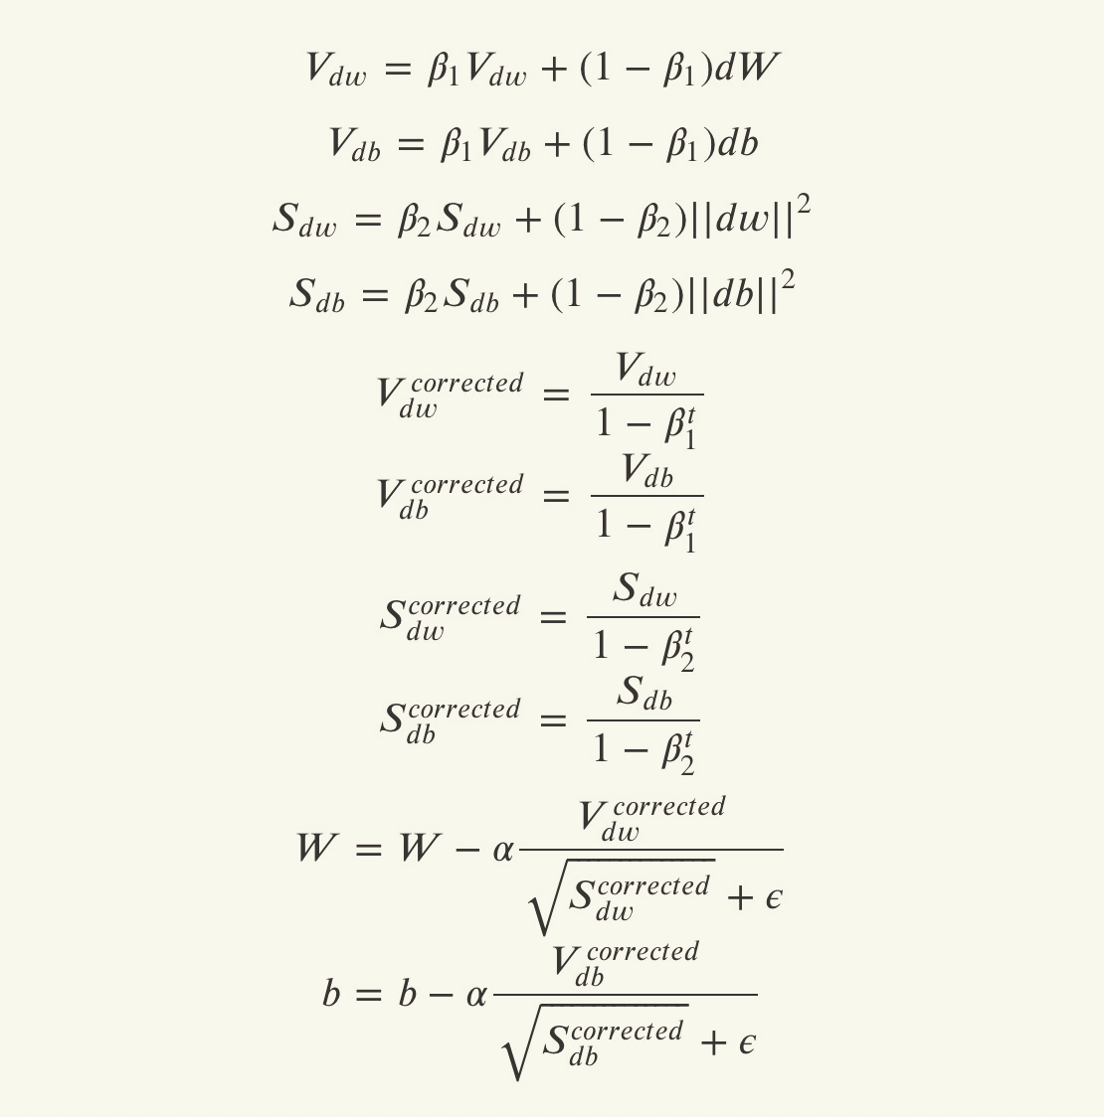
ADAM
Adam Optimizer
Combined with Momentum and RMSProp

Slide 17
Next: Convolutional neural network 卷积神经网络

